Slide 1

Movie Recommender System.
Capstone Project 2
Presented by : Aniket Daware
Batch : PGAA 8 (Andheri ,Mumbai)

Slide 2
What is Recommender System?
Prime Example why we use recommender system.
A Recommender System refers to a system that is capable of predicting the future preference of a set of items for a user, and recommend the top items.One key reason why we need a recommender system in modern society is that people have too much options to use from due to the prevalence of Internet. In the past, people used to shop in a physical store, in which the items available are limited. For instance, the number of movies that can be placed in a Blockbuster store depends on the size of that store. By contrast, nowadays, the Internet allows people to access abundant resources online. Netflix, for example, has an enormous collection of movies. Although the amount of available information increased, a new problem arose as people had a hard time selecting the items they actually want to see. This is where the recommender system comes in.

Slide 3
What can be Recommended?
There are many different things that can be recommended by the system like movies, books, news, articles, jobs, advertisements, etc. Netflix uses a recommender system to recommend movies & web-series to its users. Similarly, YouTube recommends different videos. There are many examples of recommender systems that are widely used today.

Slide 4
Why the Recommender system?
Benefits users in finding items of their interest.
Help item providers in delivering their items to the right user.
Identity products that are most relevant to users.
Personalized content.
Help websites to improve user engagement.

Slide 5
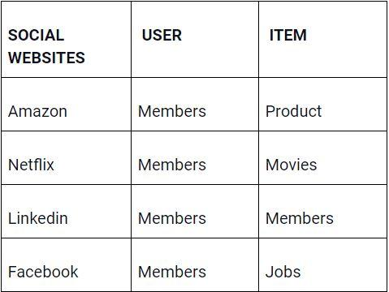
How do User and Items Matching is done?
In order to understand how the item is recommended and how the matching is done, let us a look at the images below;

Slide 6
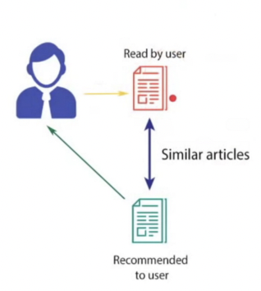
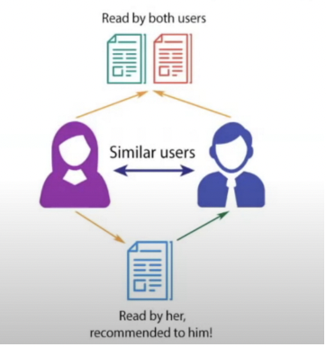
The Types of Recommendation System?
1. Popularity Based.
2. Content Based.
3. Collaborative Filtering.
Popularity based recommendation system keep a track of how many people are watching this is the most simple algorithm Eg. Trending Section of Youtube.
Content Based:
Collaborative Filtering is mostly used by Netflix.

Slide 7
Recommendation systems are among the most popular applications of data sciences.They are used to predict the Rating or Preference that a user would give to an item.
Almost every major company has applied them in some form or the other. Amazon used it to suggest products to customers, YouTube uses it to decide which video to play next on autoplay,and Facebook uses it to recommend pages to like and people to follow.
Let's Build our own recommendation system:
In this data Science project, will see how to build a model as well as content- based recommendation systems.
While these models will be nowhere close to the industry standard in terms of complexity, quality or accuracy, it will help us to get started with building more complex models that produce even better results.

Slide 8
Download the datasets we need to build this movie recommendation model from here:
TMDB 5000 Movie Dataset
About Dataset:
columns:
homepage
id
original_title
overview
popularity
production_companies
production_countries
release_date
spoken_languages
status
tagline
vote_average

Slide 9
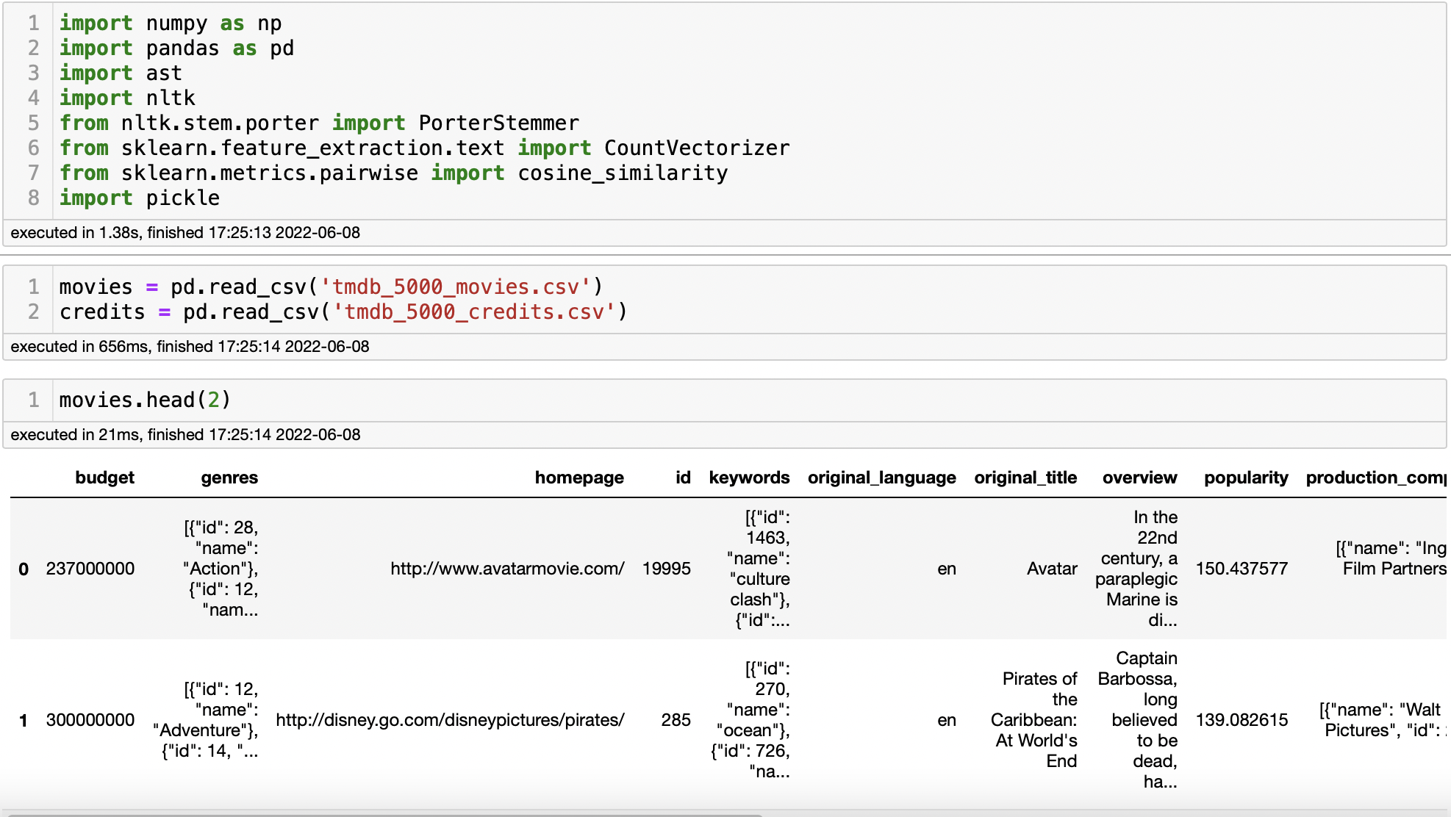
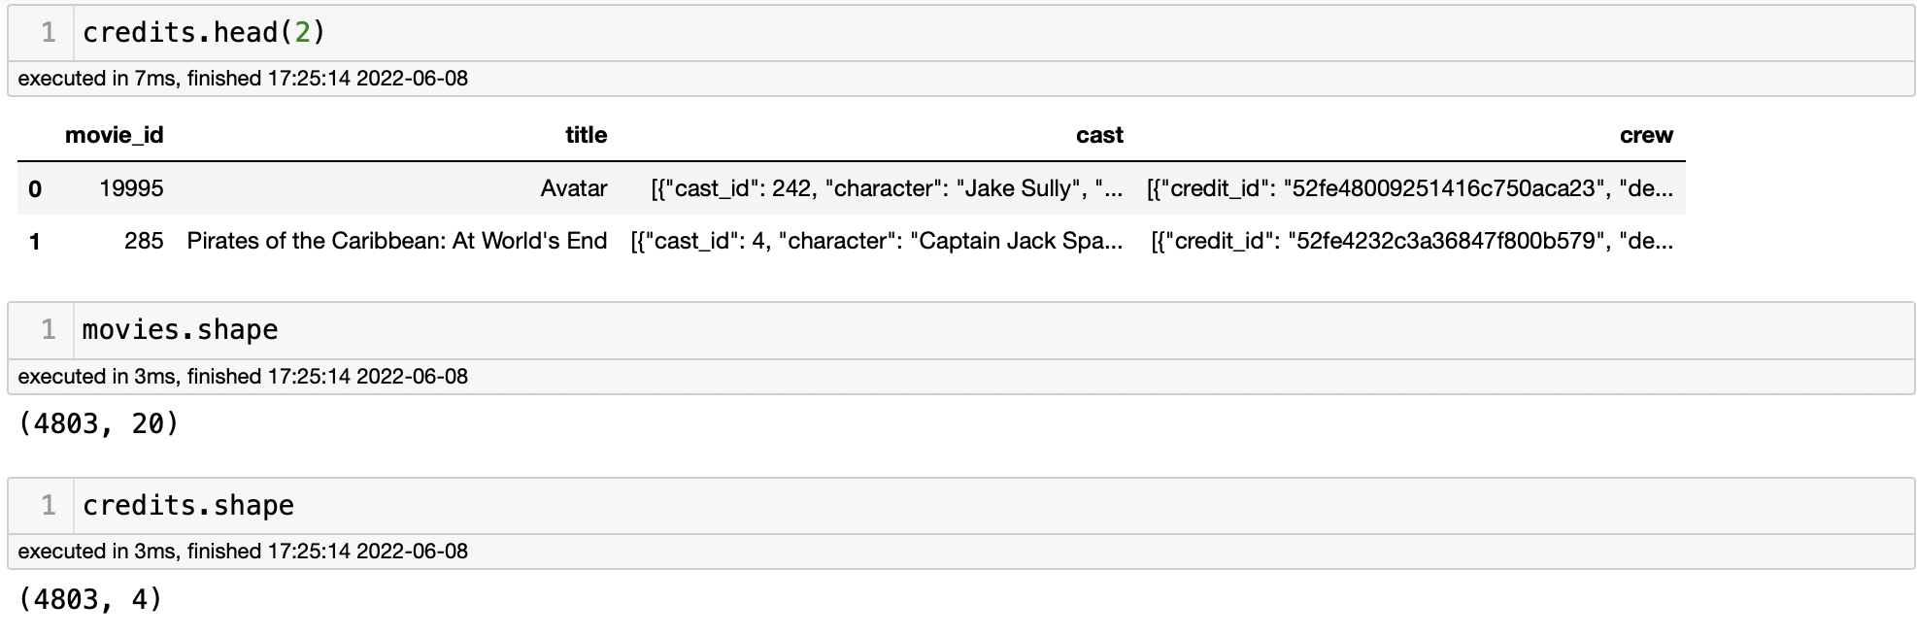
Importing the Libraries and Reading the Data.

Slide 10
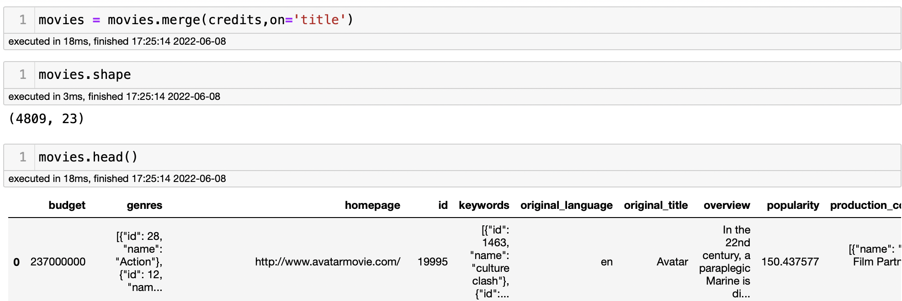
As We can see their is two dataset one is Movies an second is Credits of movies so will merge these two dataset in one single dataset “MOVIES”.
Now we have 4809 rows and 23 Columns.

Slide 11
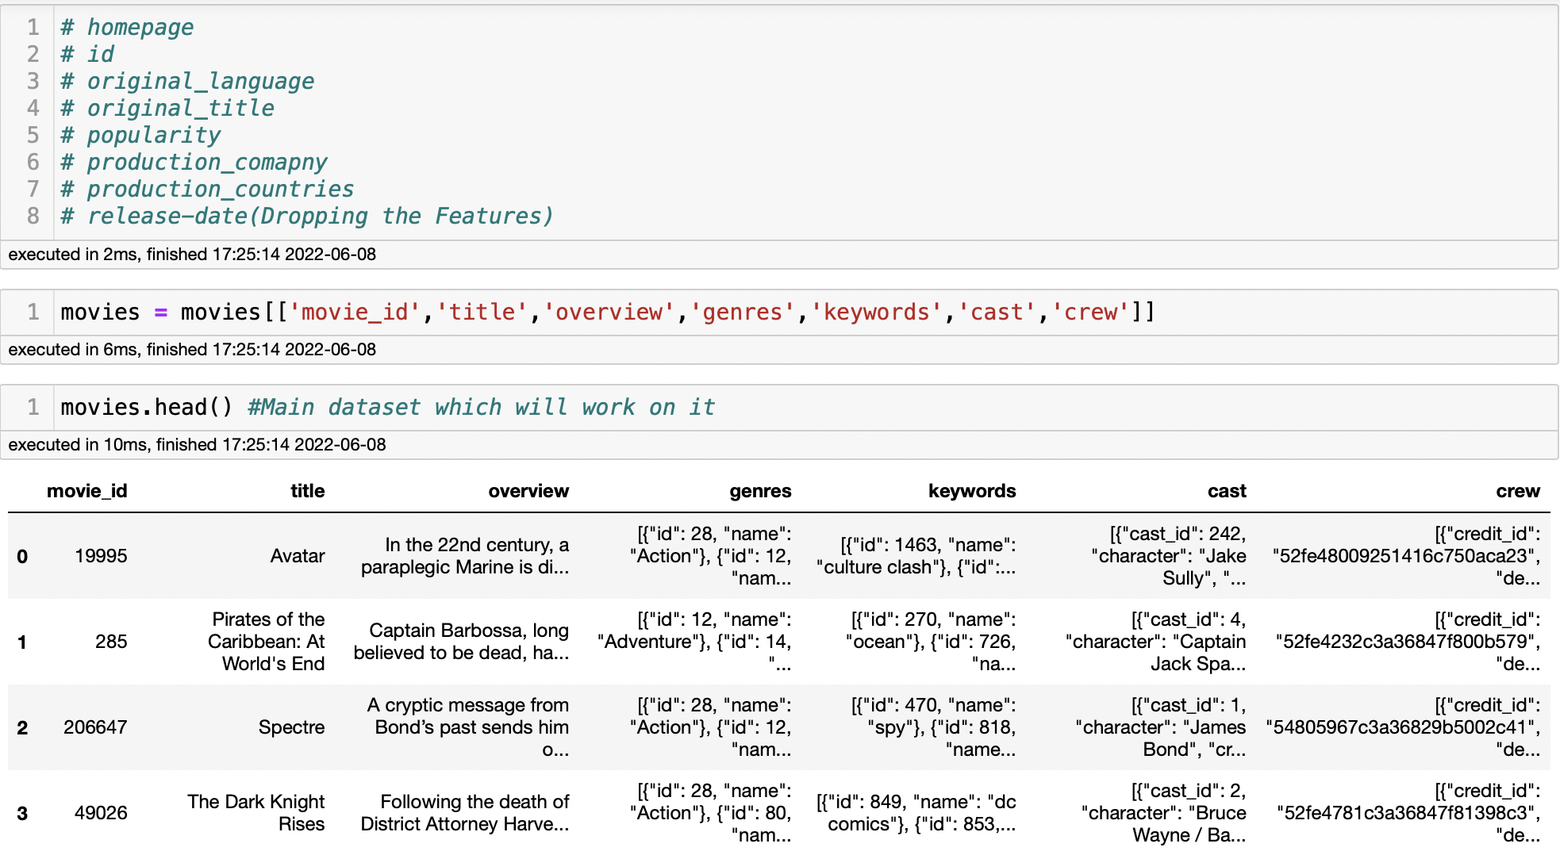
Main Dataset which will work on “Movies”, After Removing non important Features from the columns so it will easily to work on important features as well as time complexity.

Slide 12
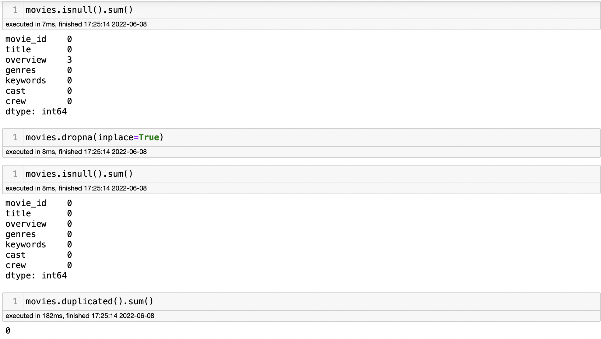
Understanding the Movies Datasets:
1.Data Types.
2.Null Values.
3.Duplicate Values.

Slide 13
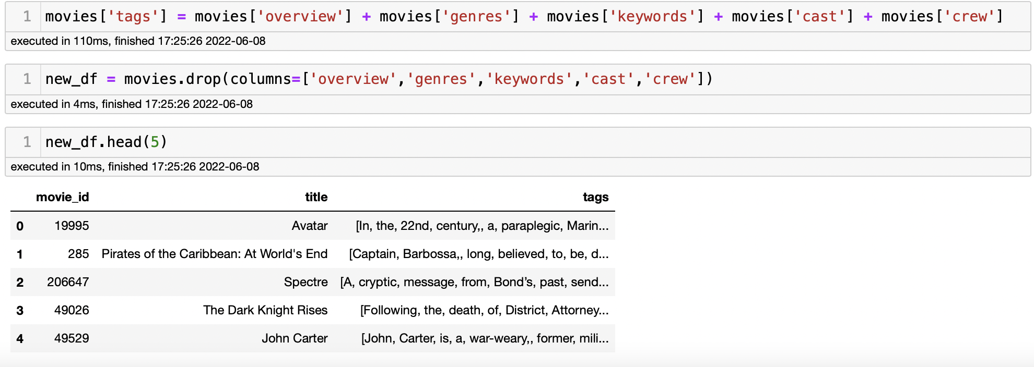
Now we got what we need from the dataset an will work on it. Further will clean this data so that we can merge that columns into one “Tags” form. “Overview” ,
“Genres”, “Keywords”, “Cast”, “Crew”. All these columns will merge an form “tags” a new column with all keywords included in that.

Slide 14
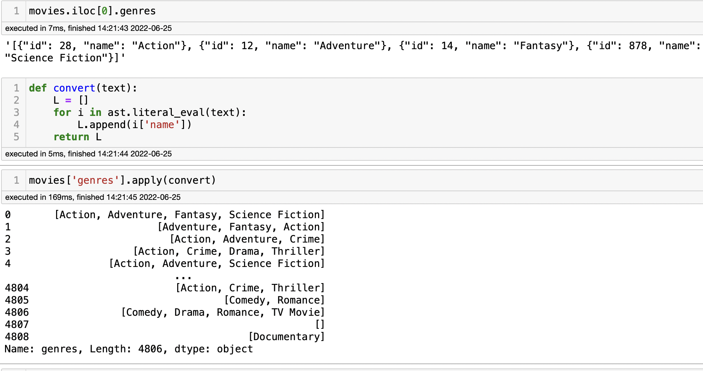
Before getting Tags Columns we need to do some data pre-processing and cleaning so that will get the tags column in the form of paragraph. First step will take Genres columns and will make them into correct format. As we can see the format of genres it in the weird format so we need to convert it. With the help for in-built function call ast.literal_eval. Now will get list of all the movies Genres now. (The ast. literal_eval method is one of the helper functions that helps traverse an abstract syntax tree.)

Slide 15
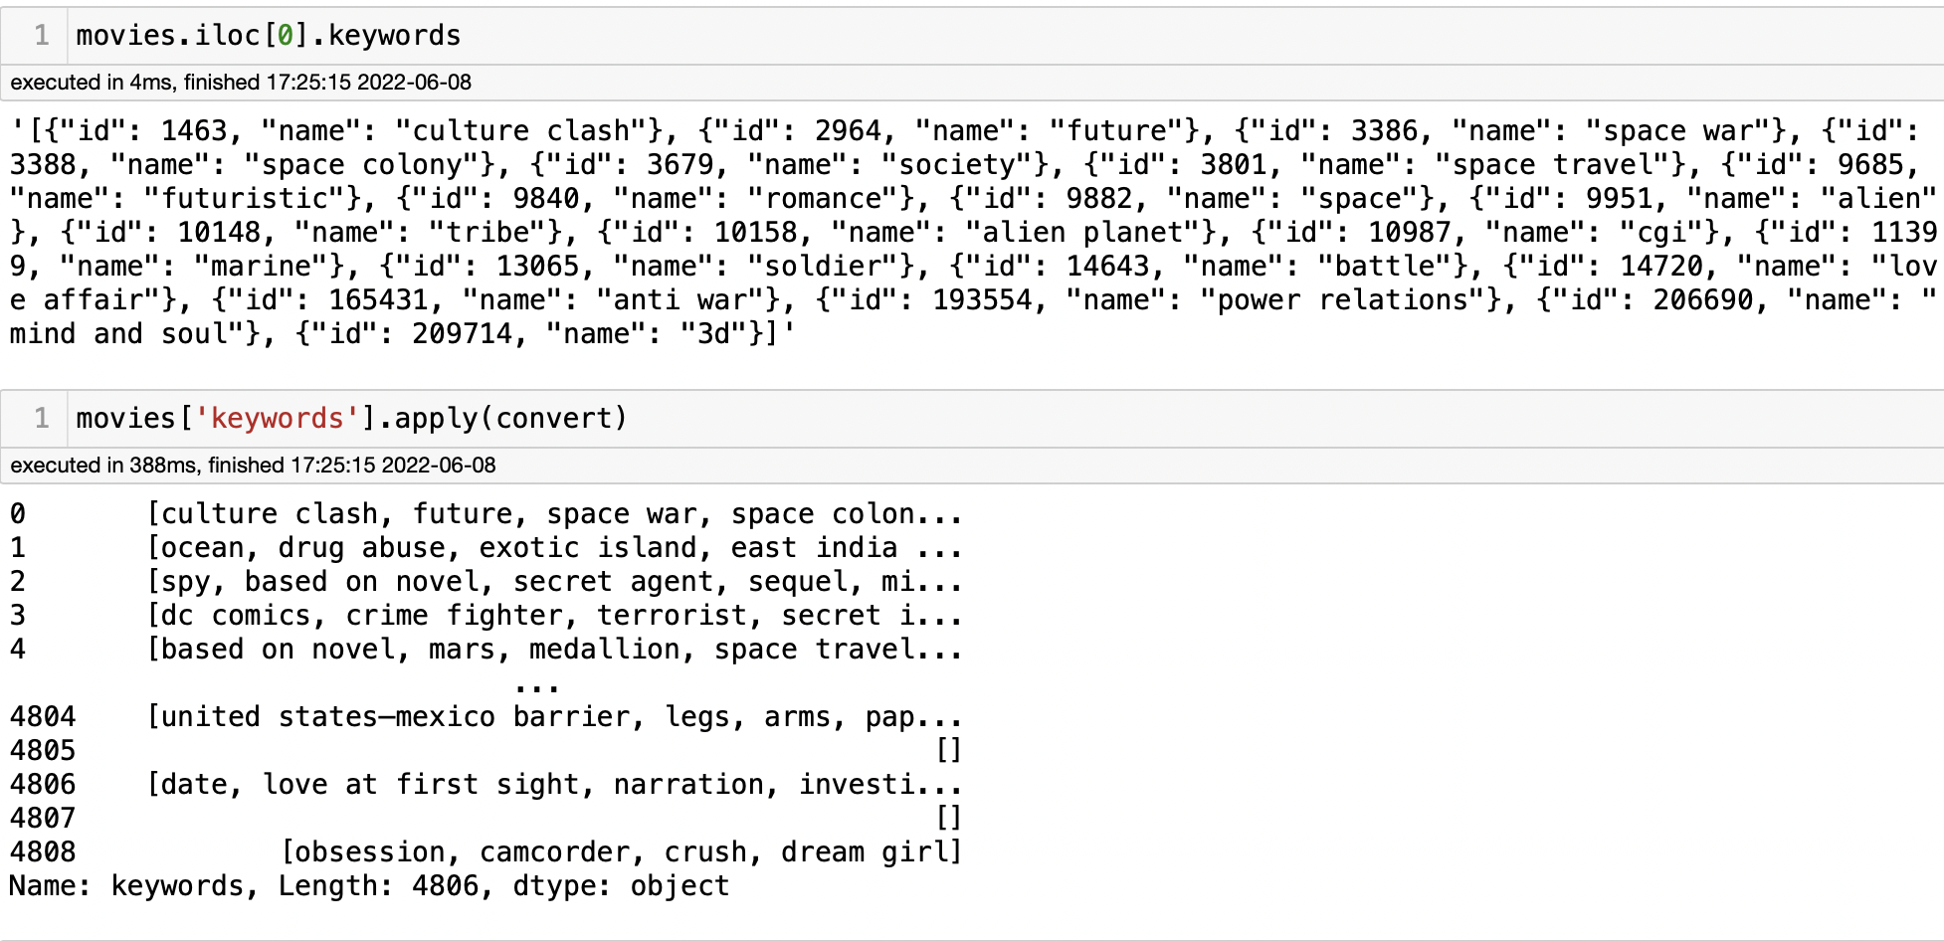
Now will do same thing on Keywords so will get one list of all the keywords present in that. As we can below how it done. As of now “Genres”,”Keywords” are in proper format. Now two more is remaining will do it know..

Slide 16
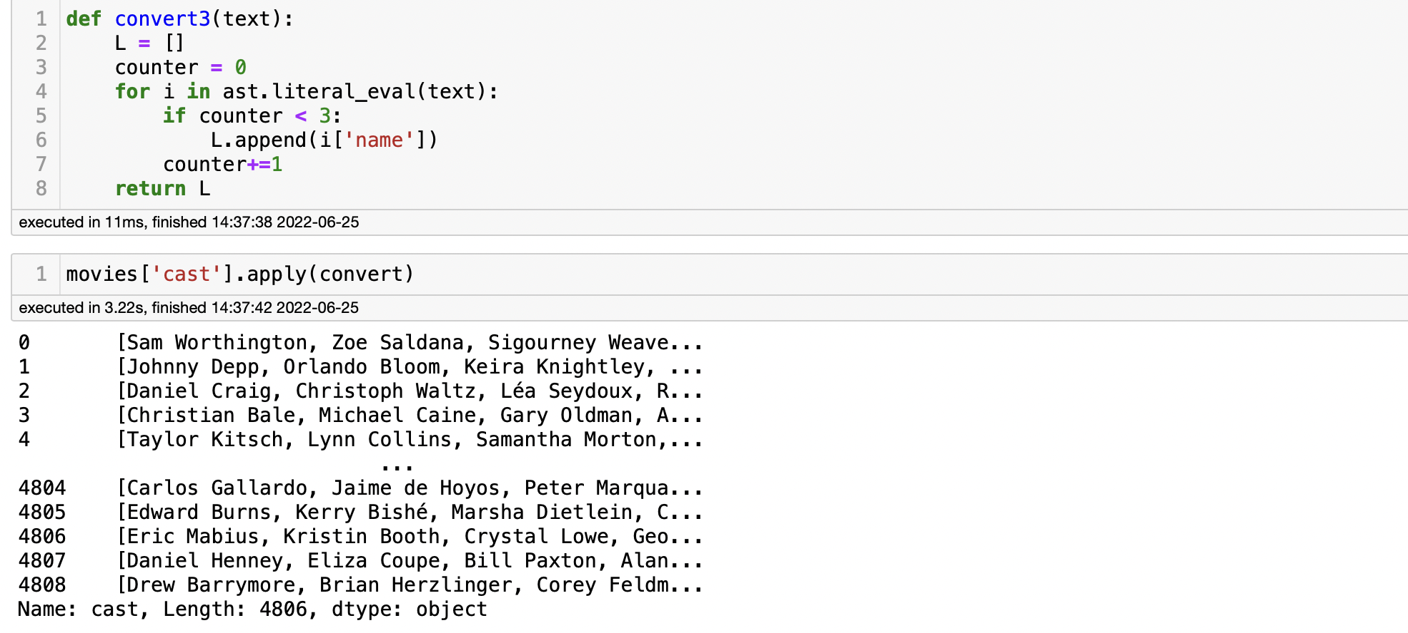
Now will do with “Cast” an will remove top 3 cast names from the movies. They are the lead actor of that movie, so will remove top 3 only renaming we dont need as of now.
Eg: Joker is the character name but his real name is Heath Ledger.

Slide 17
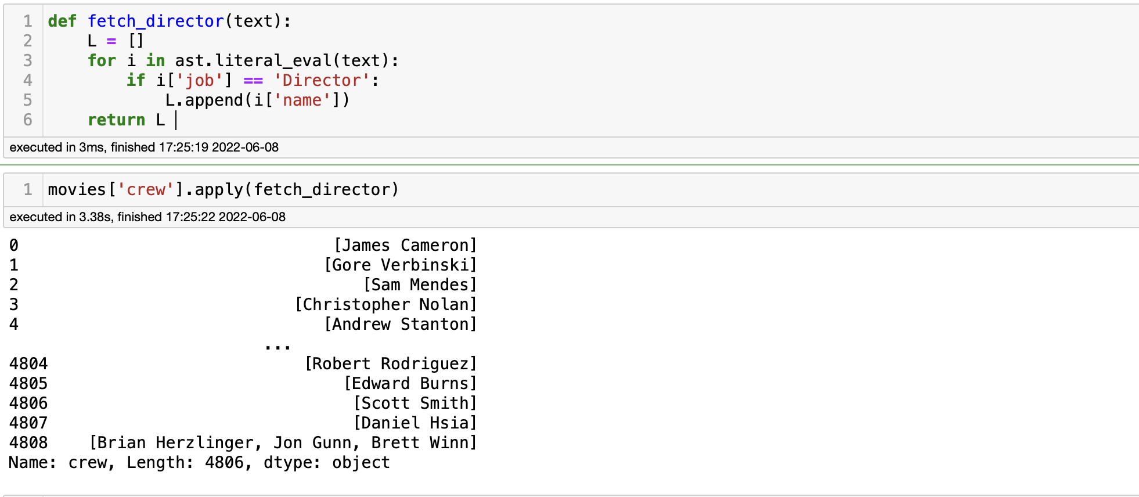
Now Crew is remaining. In these will get only Director name of that movie who has been directed by.
So majority of people watches the movie by whoms is directed, favourite actor,what type of movie is like its (Action, Drama ,Comedy…)
So we have take that thing important things we need.

Slide 18
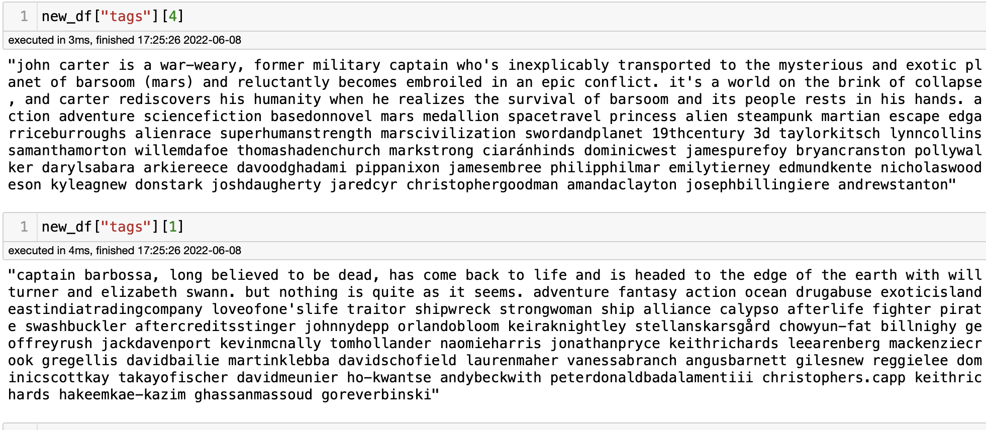
After doing all the preprocessing on the data, As of now all columns are in the from of list. So we can concatenate that list and convert into a big list an the big list will convert Dataframe an will convert into big paragraph and that paragraph will be our tags column. This will be your finally form of your dataset will look like.

Slide 19
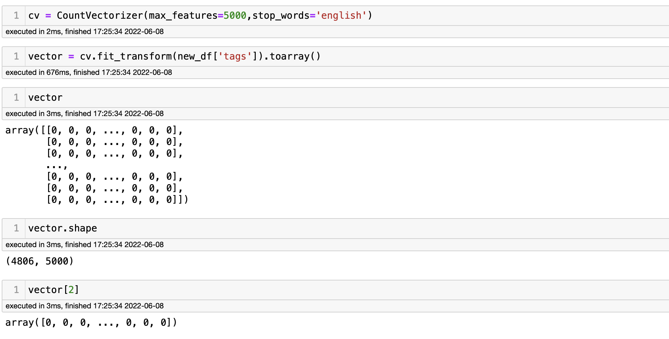
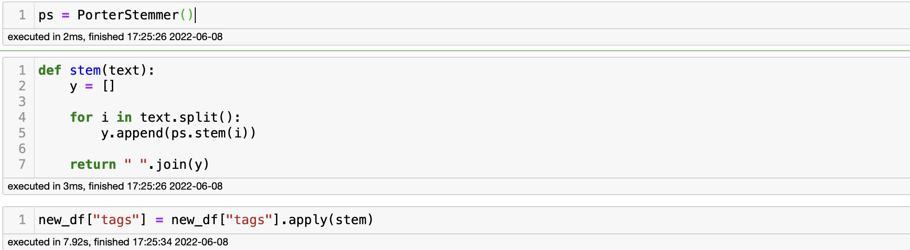
Now will convert text data into Numerical form. “Tags” column is in the form of text so will covert tags column in numerical form with the help of countvectorizer. An every movie tags will get its own vector form. From that vector will get to know which movies are related or close vector to each other. An will use Bag of Words Technique. An will use English Stopwords so it won't get biases towards repeated words. An also will use stemming on tags.

Slide 20
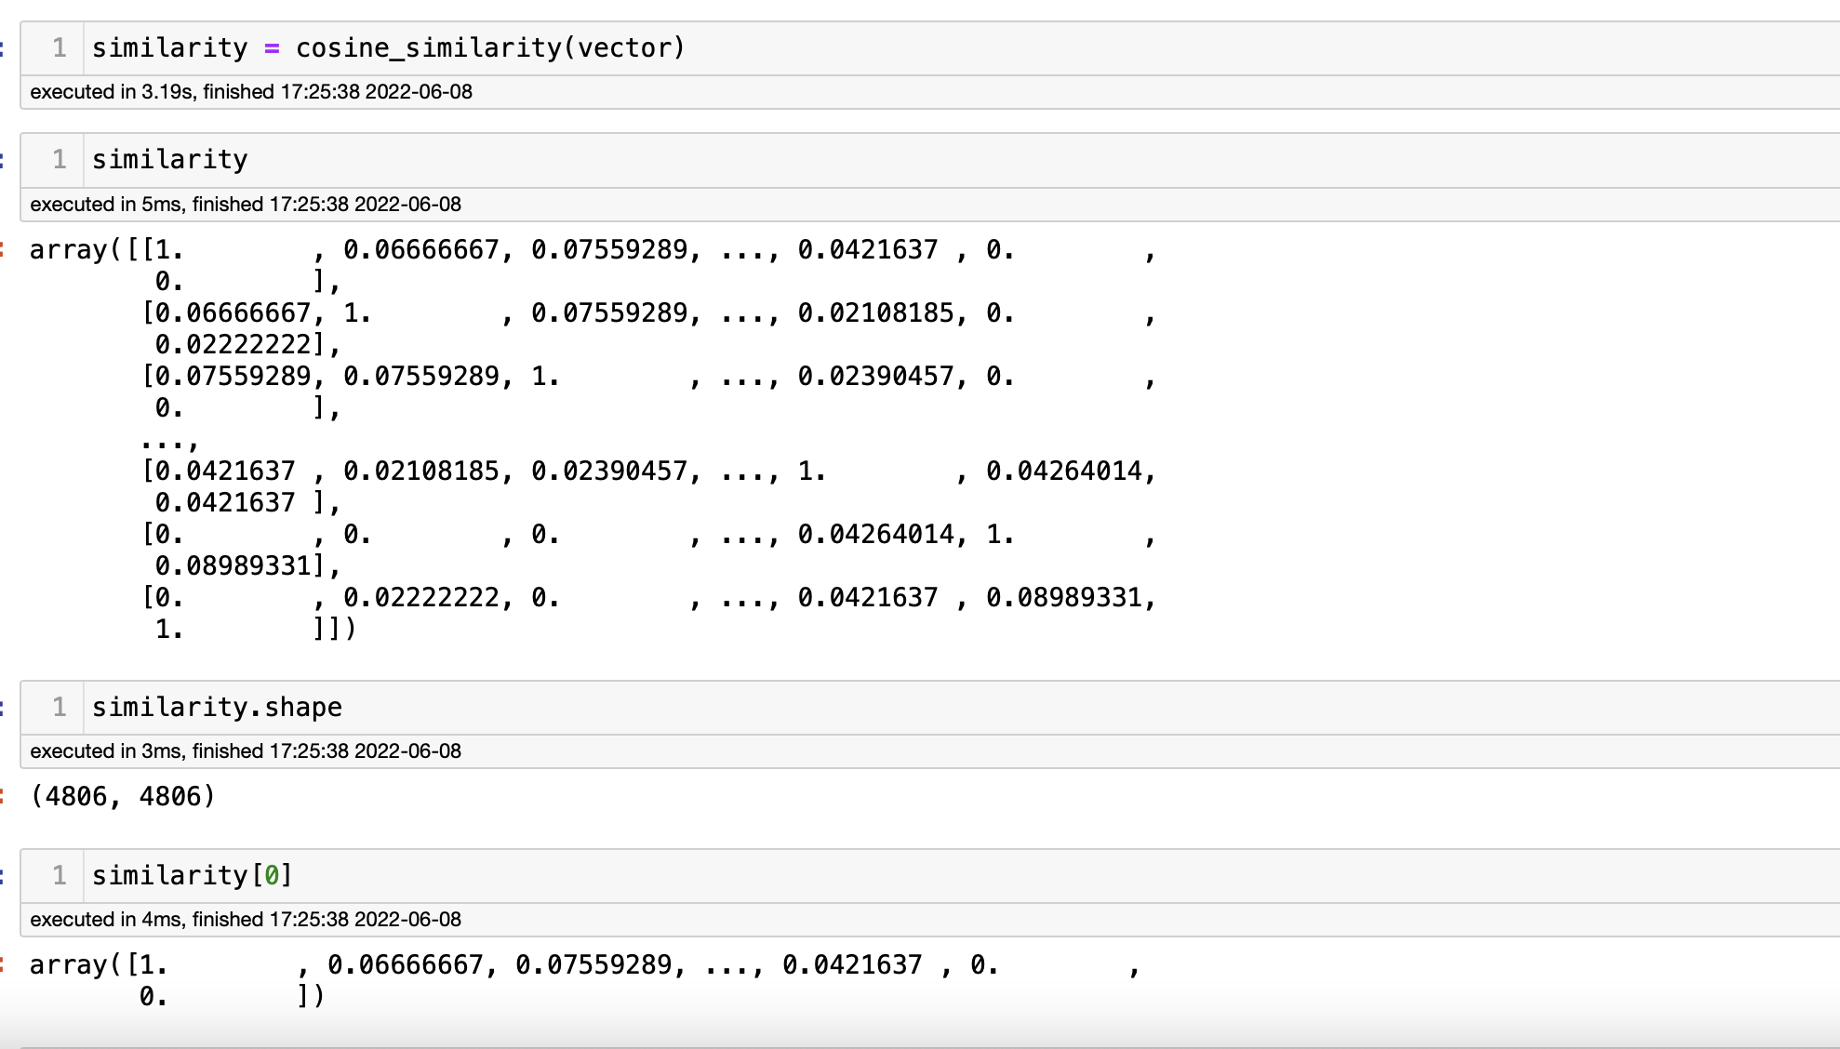
We 4806 movies and that much only vector of that movies. An each vector have 5000 numbers in that present.
Now we need to find which movie is close to each other. Every movie is the form of vector so we can say that which every vector is close to each other then that movies will recommend us in the form of top 5 movies.
First we need to calculate the distance between two vector which means it will calculate 1 movie distance with 2 movie’s distance (long the distance similarity of the movie will be less and closes distance will get high similarity)
Will use cosine distance to find the similarity of the movies. Cosine distance is nothing but the angular distance form.
Note: We can use euclidean distance also but we are working on high dimension data so there is high chances of getting fail. Euclidean distance is not good measure.

Slide 21
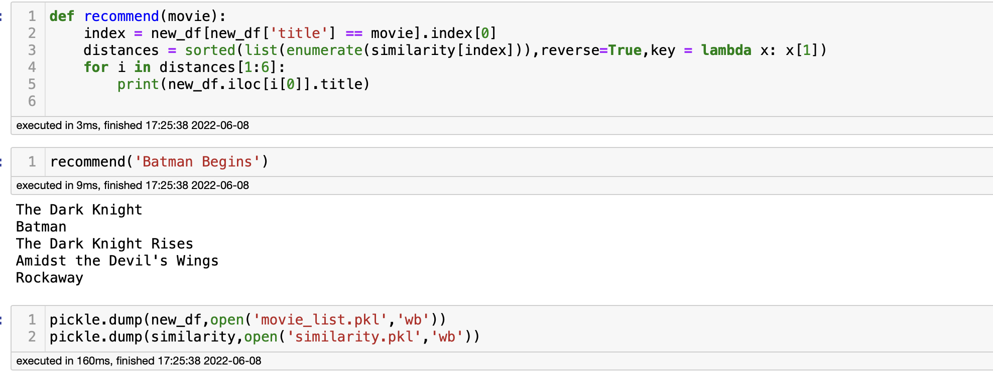
Now Everything is done.
Now will do main task which we were doing so far Recommend the (Movies)
Top 5 Movies to us.
An it working Properly it is recommend us movie which we are seeing below.Model Building is done for now in future we can do more thing in these model.
We can clearly see it working here now will convert entire things into a website. All the website making things will done in PyCharm its an ide for python development.

Slide 22
Will use pickle file to get all the list of movies an similarity which help us to make an website
Python pickle module is used for serializing and de-serializing python object structures. The process to converts any kind of python objects (list, dict, etc.) into byte streams (0s and 1s) is called pickling or serialization or flattening or marshalling.

Slide 23
For making website will use Streamlit.
Streamlit is an open source app framework in Python language. It helps us create web apps for data science and machine learning in a short time. It is compatible with major Python libraries such as scikit-learn, Keras, PyTorch, SymPy(latex), NumPy, pandas, Matplotlib etc.

Slide 24
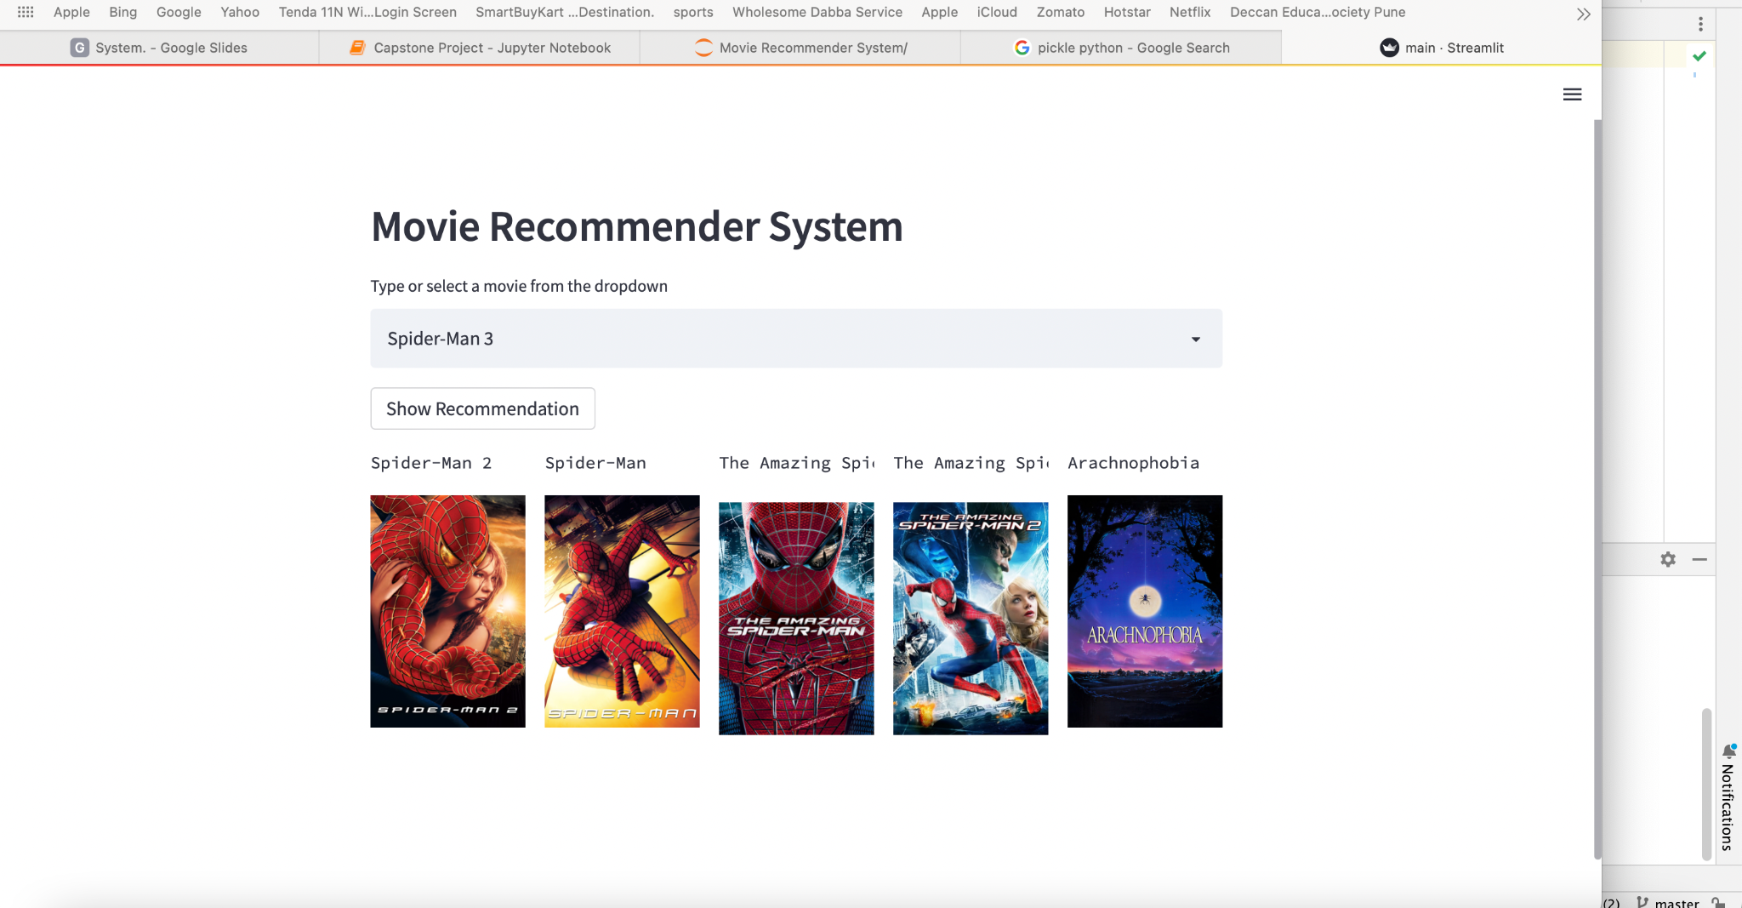

Slide 25
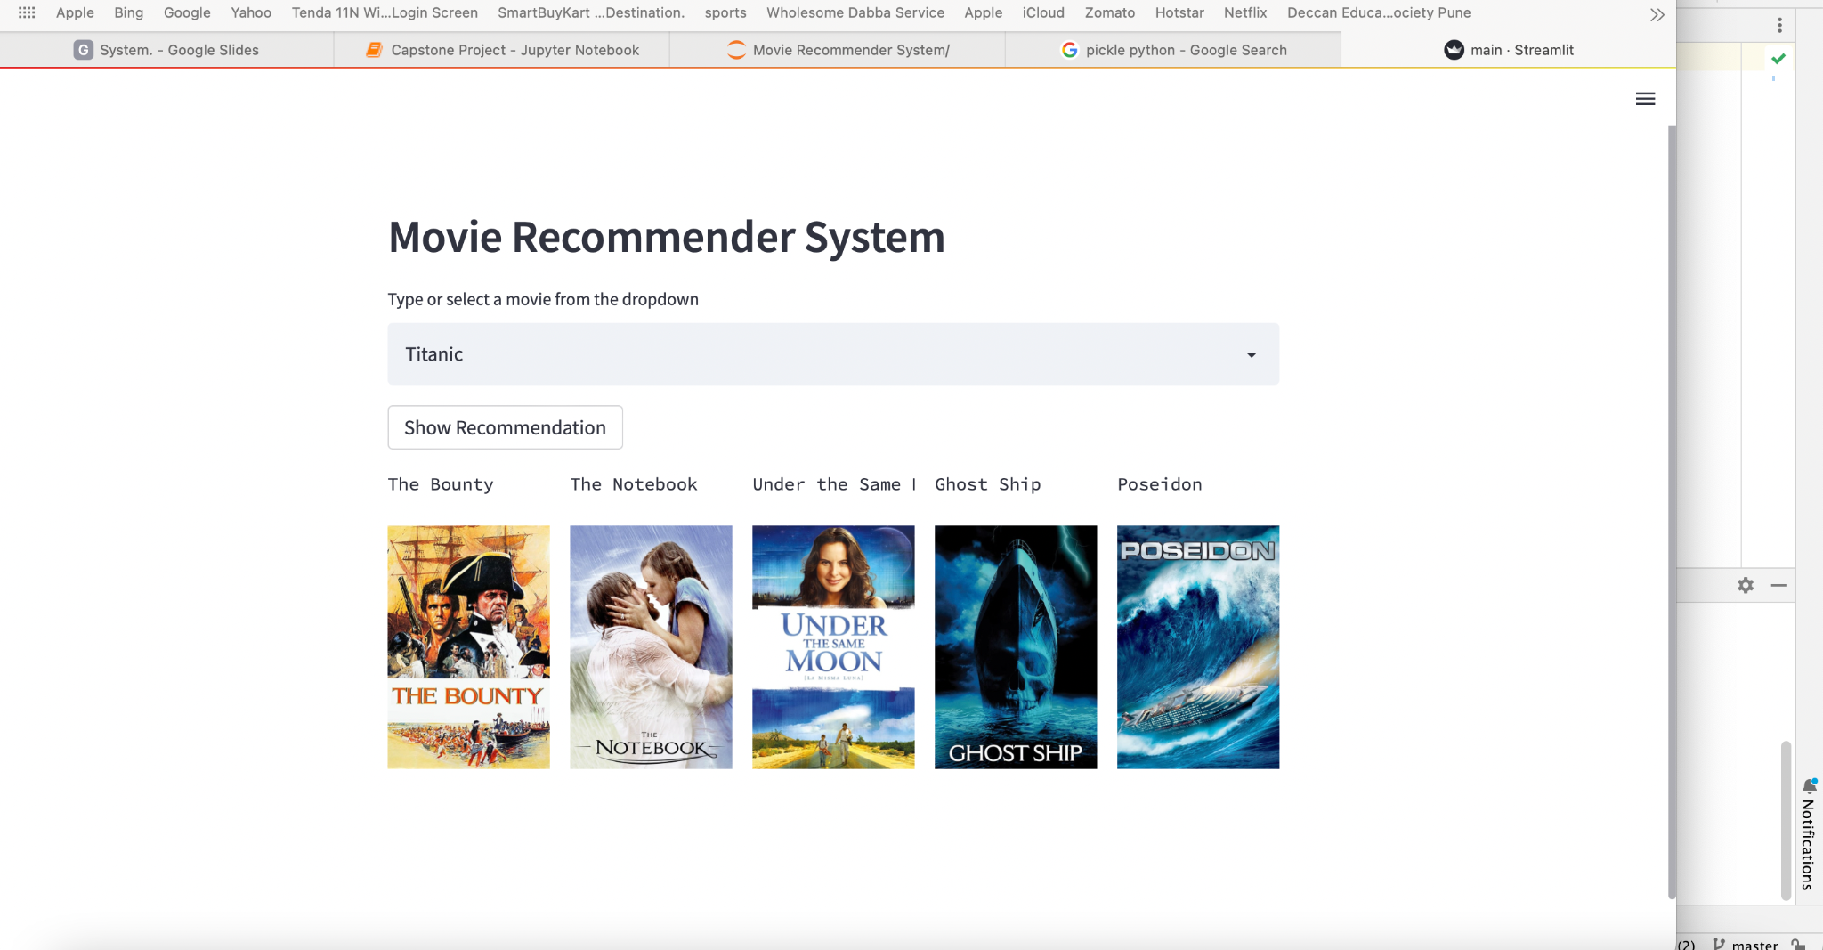

Slide 26
These how your website look like. It recommend us to top 5 movies which is closest to each other and its working successful.
Local URL: http://localhost:8501
Network URL: http://192.168.0.104:8501
Here is the url for the website which i have deployed
“Movie Recommendation System”

Slide 27
Thank You
If any question
You can find me at:
Email Id
LinkedIn
GitHub

